Slide 1
CPI 211 Final Game Post-Mortem
The Sorcerer's Journey

Slide 2
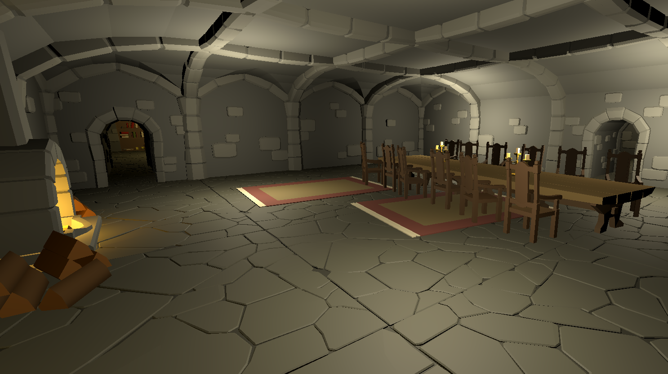
Game Overview
The Wizard’s Journey is a 3D roguelike about a wizard ascending a magical tower by blasting his way through everything in his path with a variety of spells. Standing in his way is an army of monsters ready to fire an absolutely astounding number of fireballs and other projectiles that must be dodged if the wizard is to reach his goal, the top of the tower.
Player has three Attack Spells
Player can choose from four defensive spells
Player can upgrade spells

Slide 3
What Went Good
Attack and Defensive spell implementation & animations & effects
Level Layout
Ability to Upgrade Spells
Gameplay loop
Multiple Enemy types

Slide 4
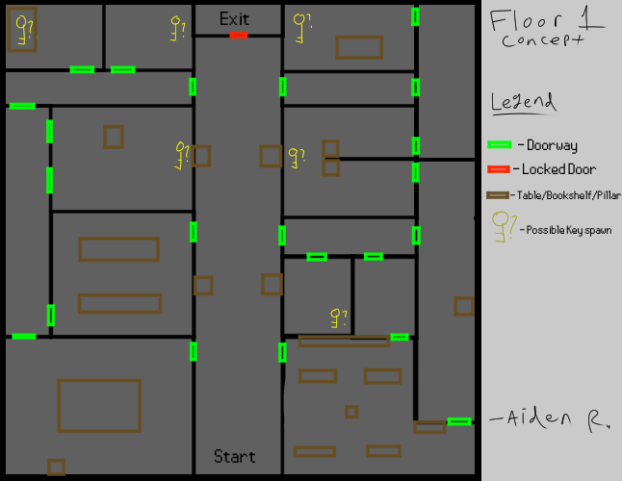
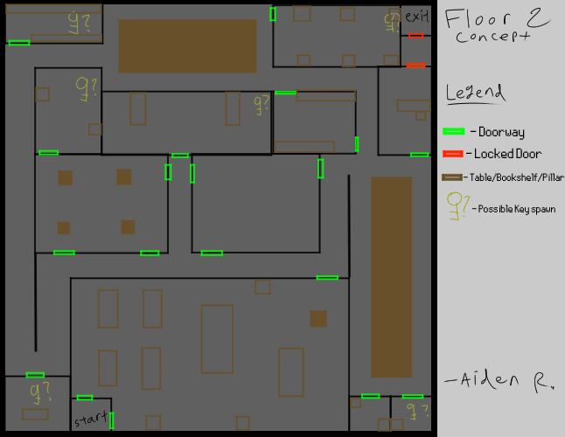
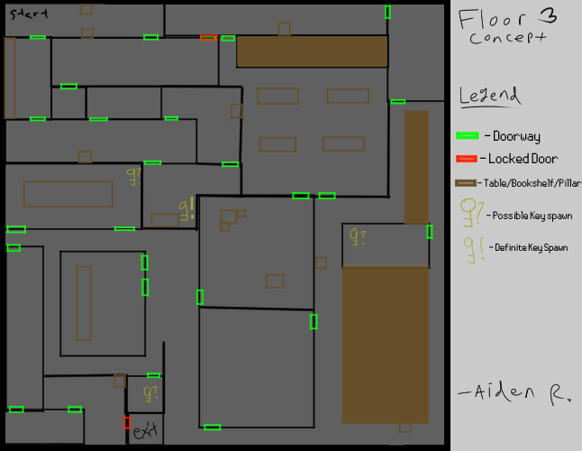
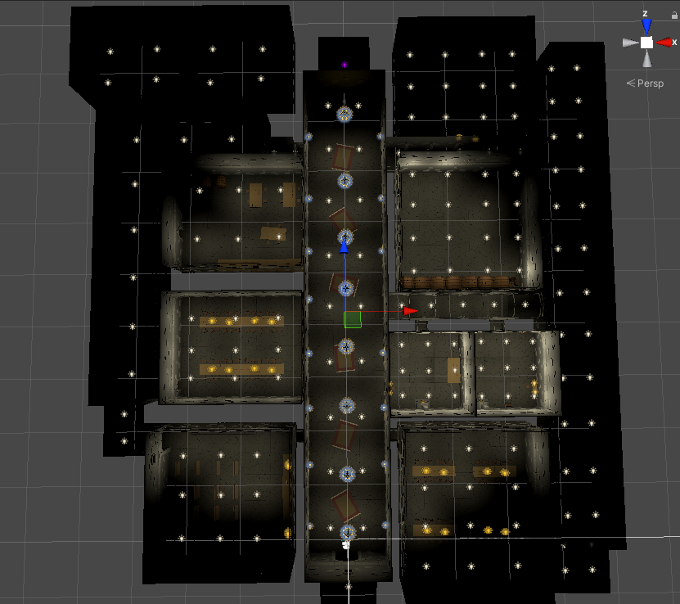
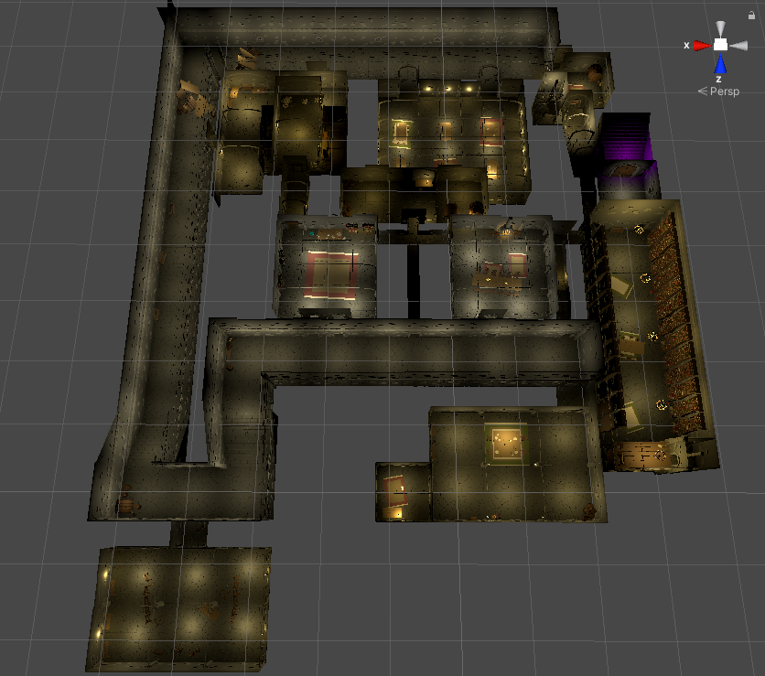
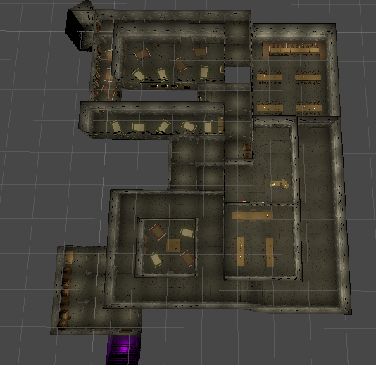
Floor/Level Concepts
Floor 1
Floor 2
Floor 3

Slide 5
Challenges/Changes
UI textures
Spawning of enemies (performance)
Removal of spell talents (gameplay feature)
GitHub problems
Communication

Slide 6
What we Learned
Approaching problems in different ways
Better understanding of level design
Programming

